Slide 1
Pre-Lab Presentation: Fluid Flow in a Straight Pipe
Group 34
Declan Falls (1083946)
Michael Wu (1079924 )
Maria Vianney Gracia (958867)
ENGR30002 Semester 2, 2020

Slide 2

Schematic Diagram
Apparatus Set-Up

Slide 3
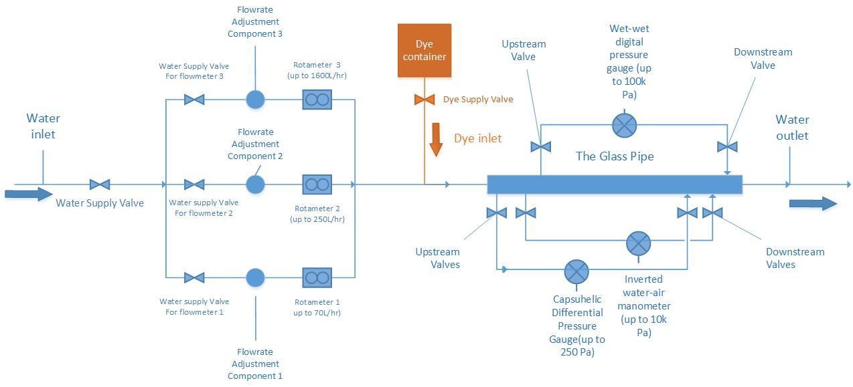
Schematic Diagram

Slide 4

Experimental Procedure
Step-by-step Instructions

Slide 5
Experimental Procedure
Set apparatus following the schematic diagram.
Check that gauges and flow meters are mounted safely and in the correct position.
Ensure all valves are set to close. All flow meters and pressure gauges should read 0 before there is any flow through the pipe.
Ensure tubes and gauges are free of dirt or moisture.
Record pipe diameter and distance between pressure gauge connections.
Open valve for the rotameter and set the flowrate to 6L/hr.
Check for leakage.

Slide 6
Experimental Procedure
Open valve for the wet-wet digital pressure gauge. If pressure drop reading is sufficiently low, open valves for the other two pressure gauges.
Wait until pressure readings in the gauges stabilise then take measurements.
After a measurement of the pressure drop across the pipe is taken, change the flow rate to the next desired value.
Repeat step 9 after an equilibration period.
Should at any point the pressure drop go above the range of a pressure gauge, close the valves connecting the line to that pressure gauge.

Slide 7
Experimental Procedure
This will result in 7-10 readings in each flow regime: laminar, transition, and turbulent.
After completion of all trials with the different flow rates, turn off the water supply.
Close the rotameter valve.
Close the pressure gauge valves.
Disconnect lines from inlet and outlet of pipe.

Slide 8

Calculation Steps
Fanning friction factor and Reynolds Number

Slide 9





Measured Parameters
Independent variable
Dependent variable
Controlled variable

Slide 10

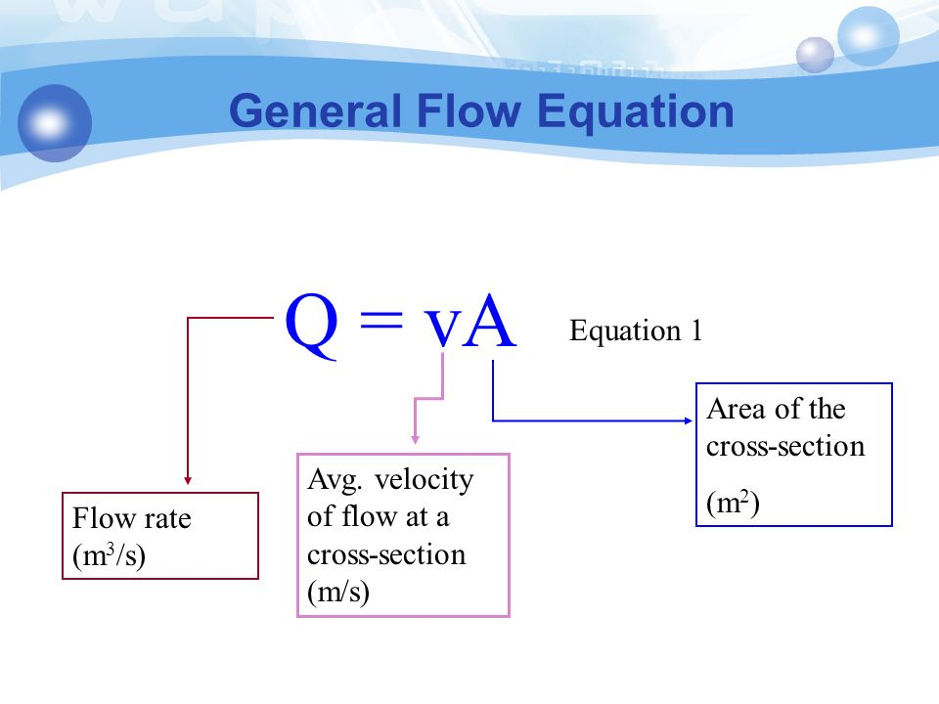
From the volumetric flow rate (Q) we can find the flow velocity (V) as
Q = V x A
After rearrange
V= Q/A

Slide 11
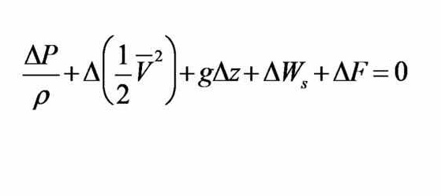
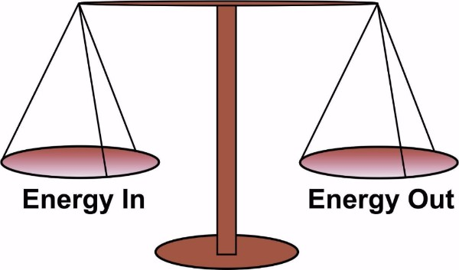
Using the Mechanical Energy Balance

Slide 12
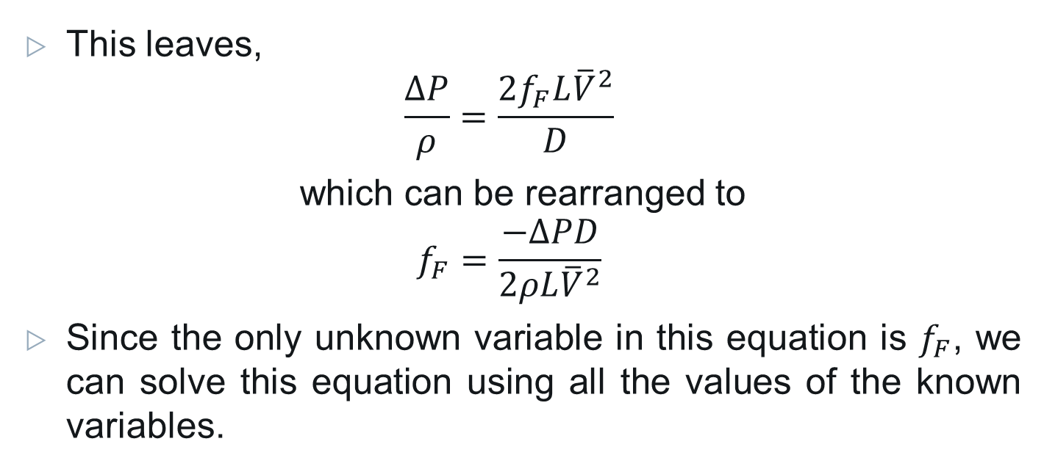
This leaves,
$$\frac{∆P}{ρ}=\frac{2f_{F}L{\overline{V}}^{2}}{D}$$
which can be rearranged to
$$f_{F}=\frac{−∆PD}{2ρL{\overline{V}}^{2}}$$
Since the only unknown variable in this equation is $f_{F}$, we can solve this equation using all the values of the known variables.

Slide 13
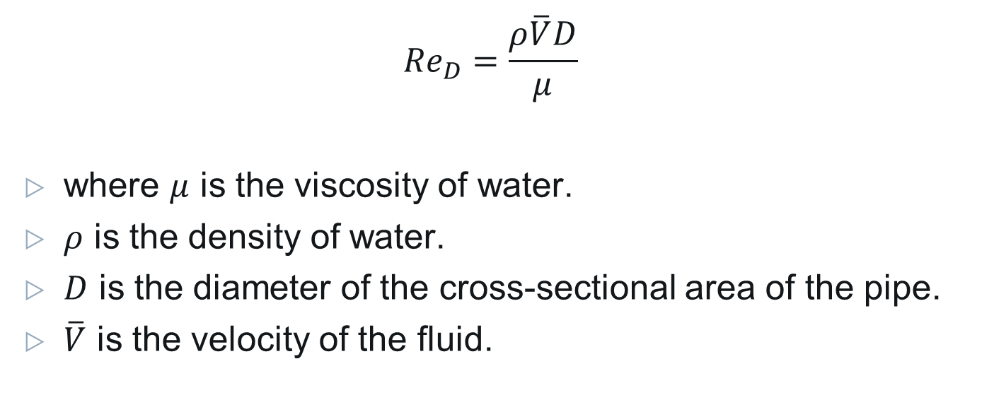
Finding Reynolds Number
$${Re}_{D}=\frac{ρ\overline{V}D}{μ}$$
where $μ$ is the viscosity of water.
$ρ$ is the density of water.
$D$ is the diameter of the cross-sectional area of the pipe.
$\overline{V}$ is the velocity of the fluid.

Slide 14

Justifications
Choices Made in Experimental Procedures

Slide 15
Number of Runs
Laminar flow: Re < 2000
Turbulent flow: Re > 3000
Transition flow: 2000 < Re < 3000
Notes:
For our experiment We want to get equal amount of data points in the three flow regime: laminar, transition, and turbulent.
Laminar flow: Re < 2000.
Transition flow: 2000 < Re < 3000.
Turbulent flow: Re > 3000.
Using the equation for the Reynolds number in the previous slide and cross sectional area of the pipe, we can obtain the volumetric flow rate corresponding to these regimes.

Slide 16
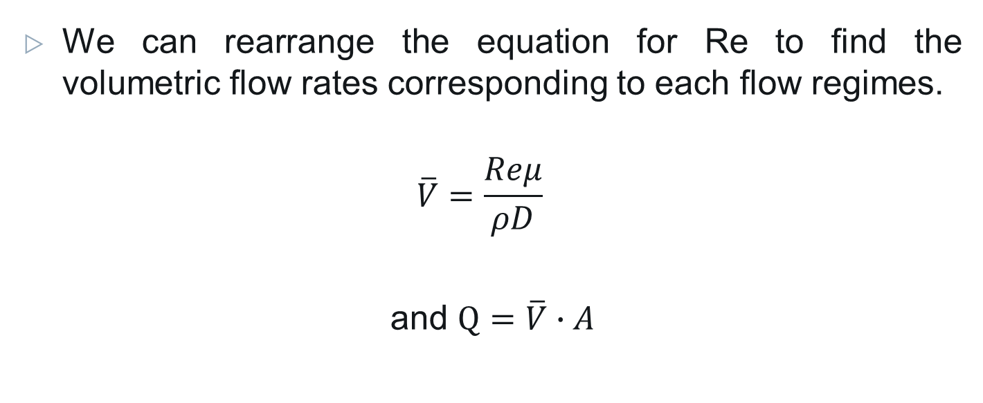
Number of Runs
We can rearrange the equation for Re to find the volumetric flow rates corresponding to each flow regimes.
$$\overline{V}=\frac{Reμ}{ρD}$$
and $Q=\overline{V}∙A$
Notes:
Use the equation michael disccussed for RE, By rearranging the equation for re and substituting the values at the flow regime limits, we can calculate the the flow rate where flow will change

Slide 17
Flow Rate Increments
We want to do 7-10 runs in each flow regime, considering the time limitation for the experiment.
Flow Regime | Laminar | Transition | Turbulent
Flow rate range (L/hr) | 0<Q<63 | 63<Q<95 | Q>95
Flow Rate increment (L/hr) | 6 | 4 | 150
Notes:
Substituting in Re=2000 and Re=3000 as the flow regime limits, we find the flow rates where flow will transition, and can then calculate by how much to increment flow rate between measurements
To do 7-10 runs in each regime, we must increment the flow by:

Slide 18
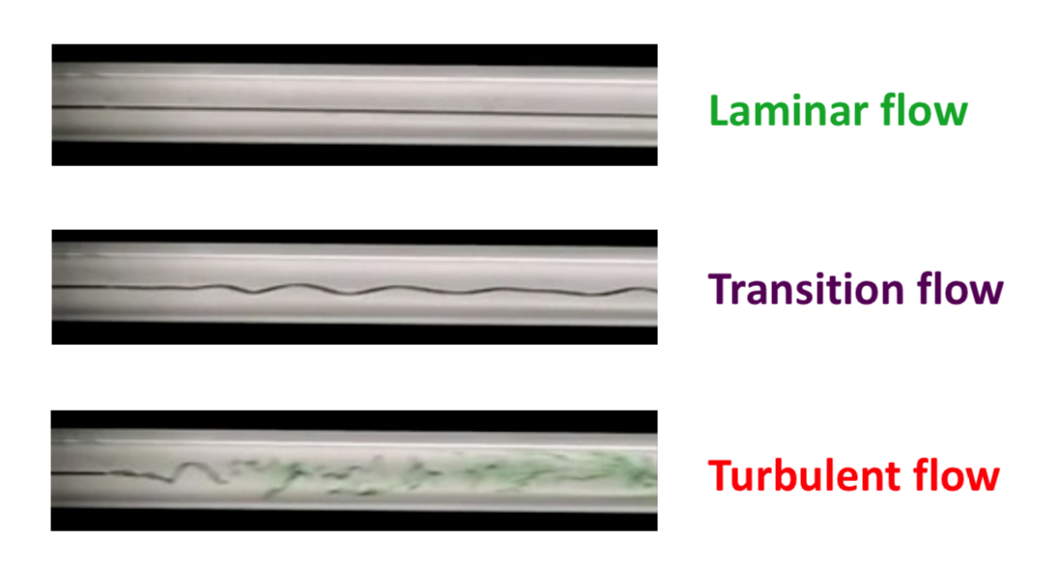
Starting Flow rate
Start with low flowrate to see the clear transition from laminar to turbulent flow with the dye.
Start with lowest range gauges, then switch over as flow rate increases
Notes:
We have decided to Start with low flowrate to see the clear transition from laminar to turbulent flow with the dye.
We will use gauge and rotameter with lower limit at the start of the lab to obtain the most accurate result. And then switch gauges as we increase the flow rate, this helps avoid damaging the gauges
Starting with high flow rate results higher pressure drop along the pipe which might damage the equipment e.g. over exceeding capacity of pressure gauges.

Slide 19
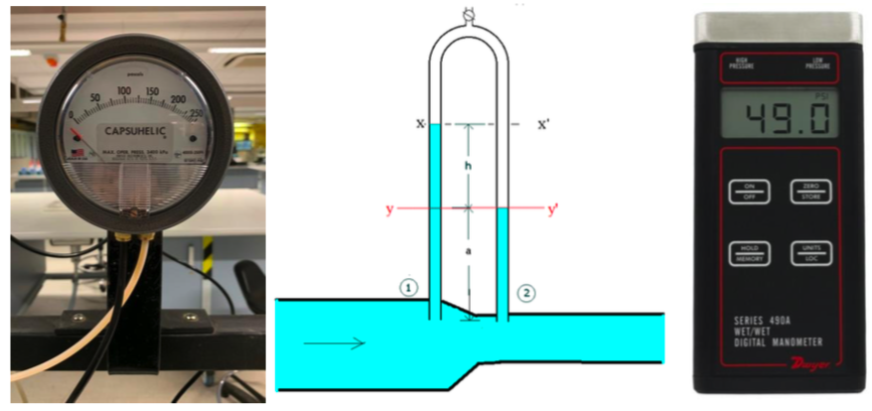
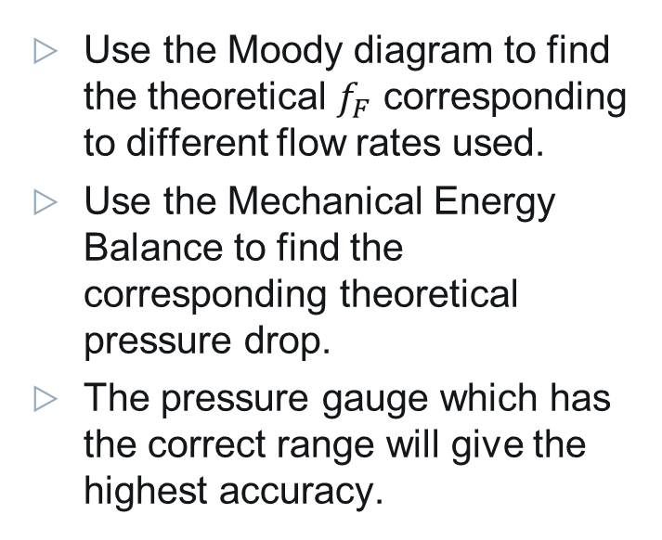
Pressure Gauge To Use
Use the Moody diagram to find the theoretical $f_{F}$ corresponding to different flow rates used.
Use the Mechanical Energy Balance to find the corresponding theoretical pressure drop.
The pressure gauge which has the correct range will give the highest accuracy.

Slide 20
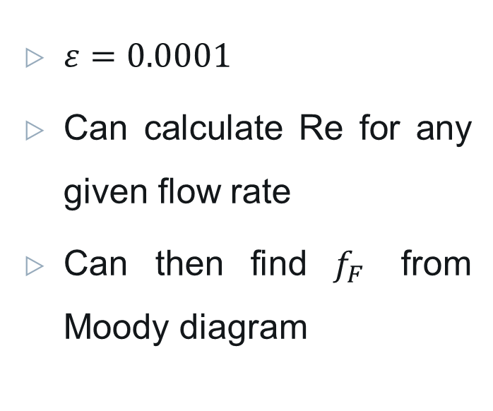
Pressure Gauge To Use
$ε=0.0001$
Can calculate Re for any given flow rate
Can then find $f_{F}$ from Moody diagram
Notes:
Native dynamics estimates glass pipe to have an absolute roughness of 0.0015mm
Pipe has diameter 12.6mm

Slide 21

Pressure Gauge To Use
Rearranging the MEB, we get
$$∆P=\frac{2{ρf}_{F}L{\overline{V}}^{2}}{D}$$
Flow Rate (L/hr) | Estimated ∆P (pa) | Pressure gauge to use
<130 | <250 | Capsuhelic differential
130-1200 | 250<∆P<10,000 | Inverted water-air
>1200 | >10,000 | Wet-wet digital

Slide 22

Pressure Gauges
Apparatus Connection

Slide 23
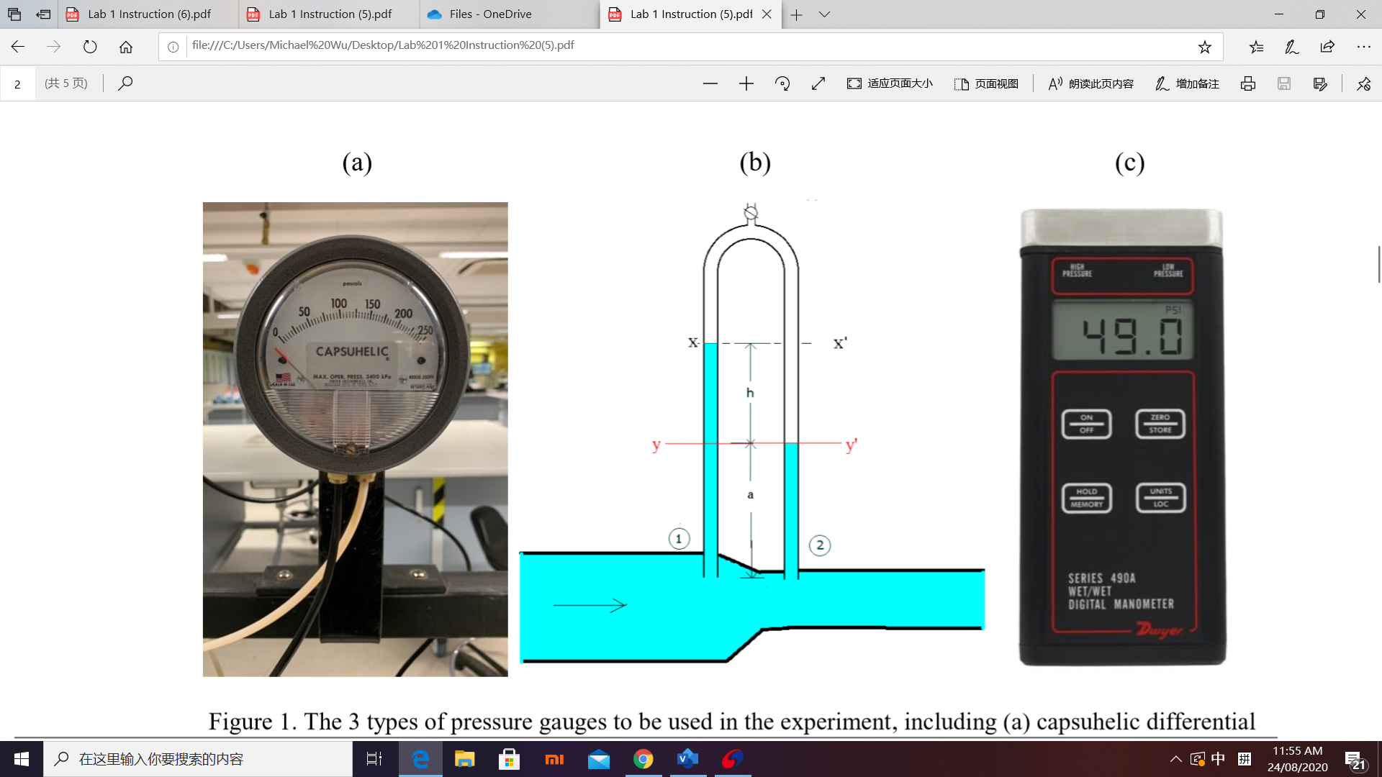
Connecting Pressure Gauge
Capsuhelic differential pressure gauge- connect the brass connection fittings to the back port of the gauge and then connect the tubes to the two ends of the pipe to measure the pressure difference. It is also important to make sure seal tape is used while screwing the brass connection to prevent any air leaks that might affect the pressure result.

Slide 24
Connecting Pressure Gauge
Inverted water-air manometer- connect the tube to the two ends of glass pipe. Due to the different amount of force applied to the fluid, the amount of fluid been pushed up into the manometer from the two ends are different and pressure differences can be calculated.
Wet-wet digital manometer- Connect the tubing to the two ends of the pipe and read the pressure difference.
Leave Gaps

Slide 25
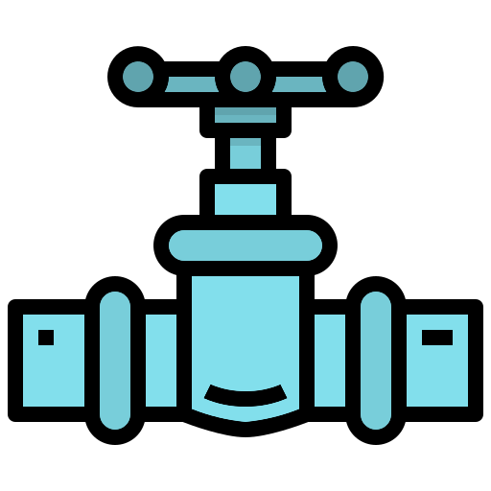
Flow Meters
Apparatus Connection

Slide 26
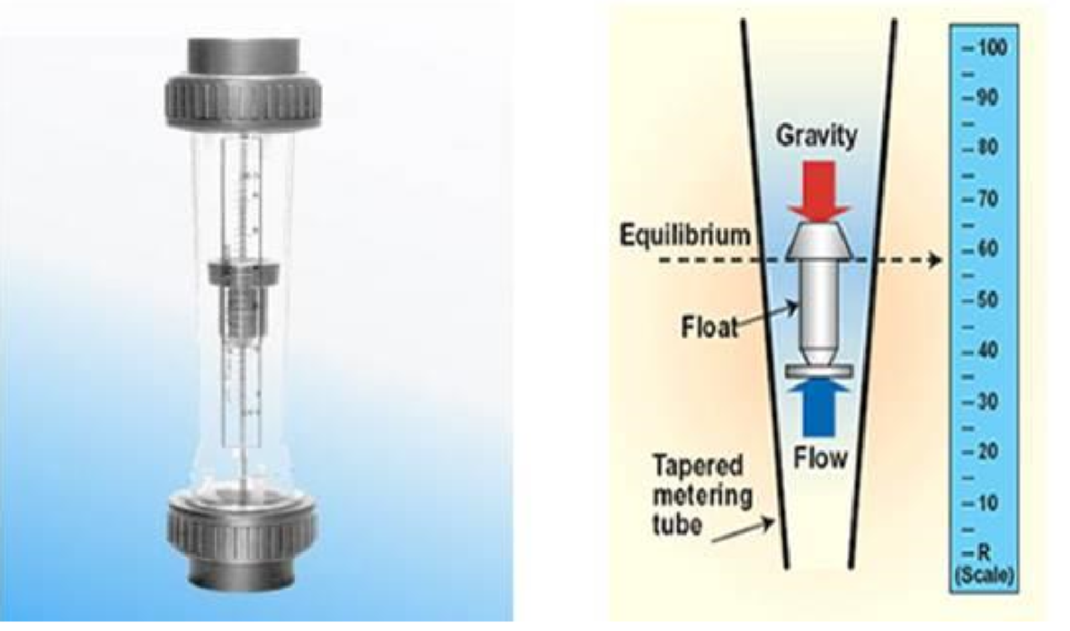
Connecting Flow Meter
The flow meters will be connected at the start of the piping, just after the flowrate adjustment components.
Because of the way rotameters work, they must be connected vertically and in-line with the piping for accurate readings
The connection of flow meter will cause pressure difference (when flow increase, more pressure drops occurs) therefore it needs to be attached at the start of the piping to get accurate measures.

Slide 27

References

Slide 28
References
“Absolute roughness of pipe material” Neutrium, Native Dynamics, 19 May 2012, neutrium.net/fluid-flow/absolute-roughness-of-pipe-material/.
https://www.youtube.com/watch?v=kIjMzpzQ6wo&t=104s
Ahmari, H. and Kabir, S., 2020. Experiment #4: Energy Loss In Pipes. [online] Uta.pressbooks.pub. Available at: <https://uta.pressbooks.pub/appliedfluidmechanics/chapter/experiment-4/> [Accessed 24 August 2020].

Slide 29
References
Warwick.ac.uk. 2020. [online] Available at: <https://warwick.ac.uk/fac/sci/eng/staff/ymc/teaching/zhigang/handout.pdf> [Accessed 24 August 2020].
Kau.edu.sa. 2020. [online] Available at: <https://www.kau.edu.sa/Files/0057863/Subjects/Chapter%208.pdf> [Accessed 24 August 2020].

Slide 30
Thank you!
Any questions?

